Slide 1
SOFTWARE QUALITY ENGINEERING
PROJECT PRESENTATION

Slide 2
GROUP MEMBERS
 | NAME | REGN. NO. | CLASS
1. | Hiba Akram | 175446 | BESE-7A
2. | Imama Jawad | 199244 | BESE-7A
3. | Nadir Ali | 192752 | BESE-7A
4. | Shabeeh Fatima | 189388 | BESE-7A

Slide 3
1.
THE SYSTEM
A BRIEF OVERVIEW

Slide 4

TRAVEL
Place your screenshot here
Provides travel locations
Locations categorized as Family, Religious, Adventurous etc.
Books Transport
Services and Packages

Slide 5
WEBSITE USERS
Users
Admin
Customer

Slide 6
ADMIN
ADD / UPDATE / DELETE USERS
ADD / UPDATE / DELETE LOCATION CATEGORIES
FUNCTIONS OF THE ADMIN
ADD / UPDATE / DELETE TRAVEL PACKAGES
ADD / UPDATE / DELETE ADVERTISEMENTS

Slide 7
CUSTOMER
Choose a Travel location
Book a Travel Vehicle
Choose a Travel Package
Cancel a Booking

Slide 8
BUILDING BLOCKS OF THE WEBSITE
HTML / CSS / JS FRONT-END / BACK-END
PHP COMMUNICATION WITH THE DATABASE
PHPMyAdmin DATABASE

Slide 9
TESTING
THIS SECTION DESCRIBES THE MULTIPLE TESTING TECHNIQUES APPLIED ON THE WEBSITE

Slide 10
SYSTEM TESTING

Slide 11
TOOLS USED
Sqlmap BlazeMeter Pingdom
Neoload Dotcom-monitor Selenium
Sucuri Quttera PowerMapper
Selenium keycdn
Pentest Tools GTMetrix
Probely PageInsight

Slide 12
TYPES OF TESTING
Penetration Testing Smoke Testing
Security Testing Fuzz Testing
Usability Testing
Load Testing
Stress Testing
Performance Testing

Slide 13
PENETRATION TESTING
Ethical Hacking
Performed to evaluate the security of the system
To find security vulnerabilities that an attacker could exploit
TOOLS USED
Sqlmap
Pentest Tools
Probely

Slide 14
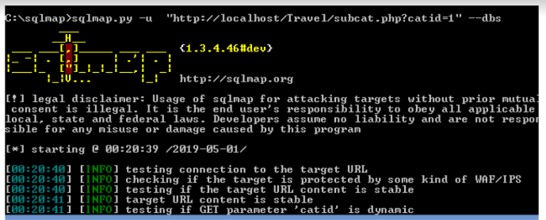
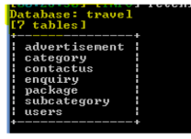
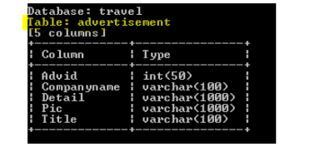
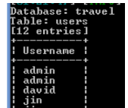
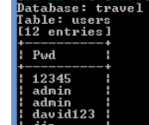
SQLMAP

Slide 15
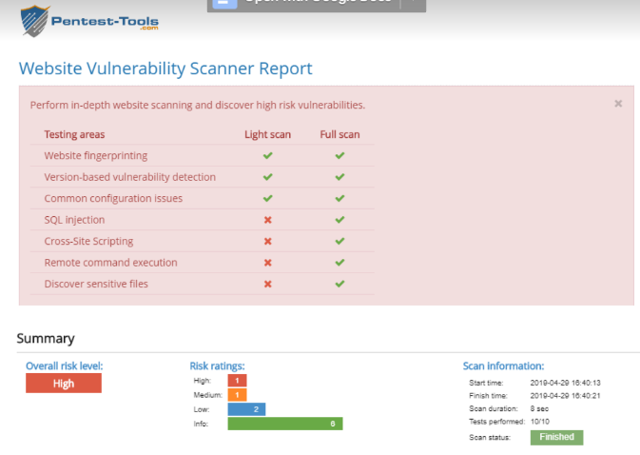
PENTEST TOOLS

Slide 16
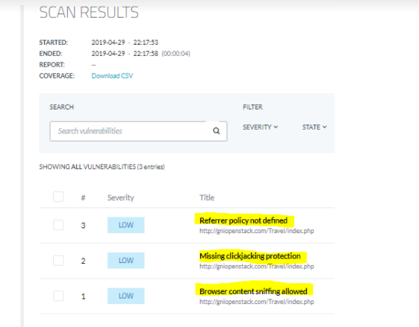
PROBELY

Slide 17
SECURITY TESTING
In order to assure that data within some information system stays secure and not accessible by unapproved users.
TOOLS USED
Sucuri
Quttera

Slide 18
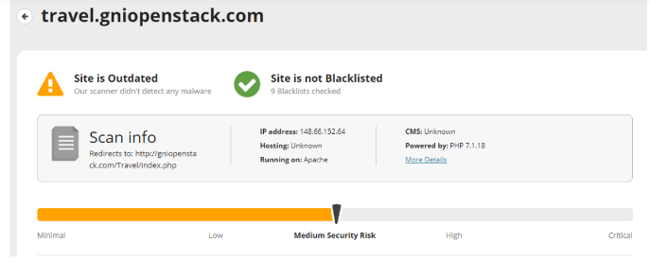
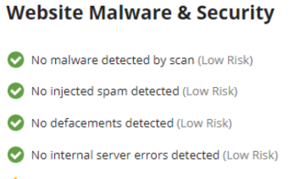
SUCURI

Slide 19
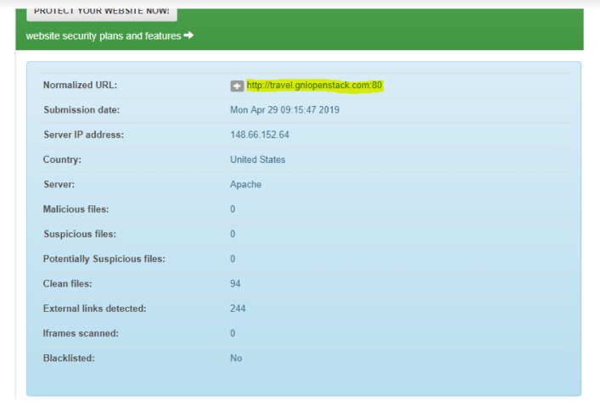
QUETERA

Slide 20
LOAD TESTING
It determines a system's performance under real-life load conditions.
Helps determine how the application behaves when multiple users access it simultaneously.
TOOLS USED
Neoload
LoadImpact
Blazemeter

Slide 21
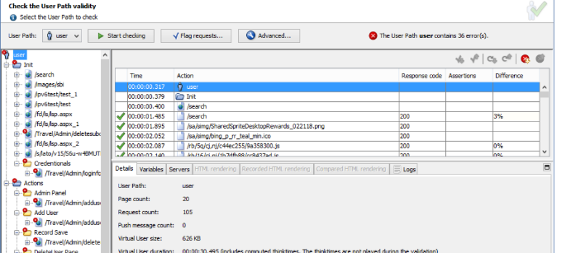
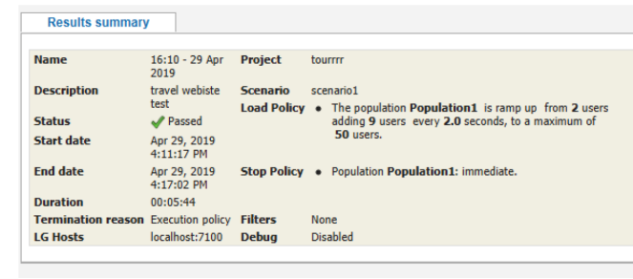
NEOLAD

Slide 22
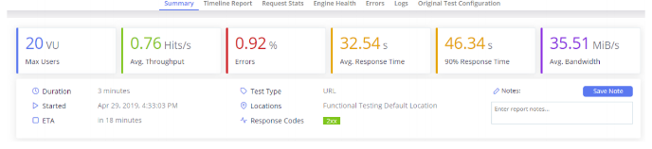
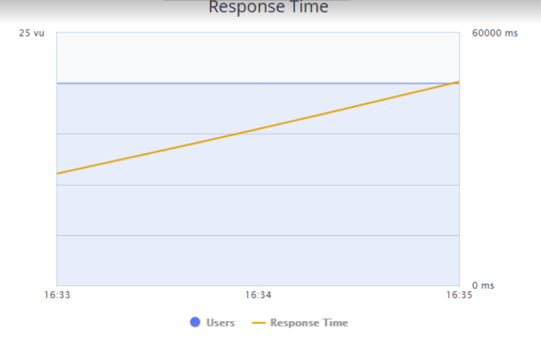
BLAZEMETER

Slide 23
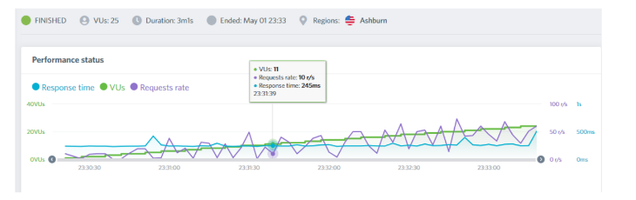
LOADIMPACT

Slide 24
STRESS TESTING
Checks stability and reliability of the system
The stress testing mainly determines the system on its robustness and error handling under extremely heavy load conditions.
TOOLS USED
Neoload
Dotcom-monitor

Slide 25
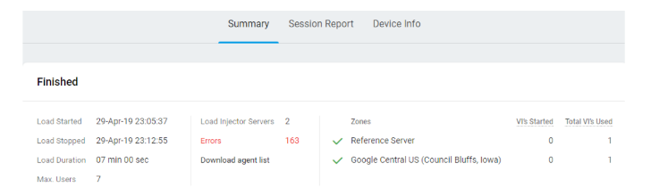
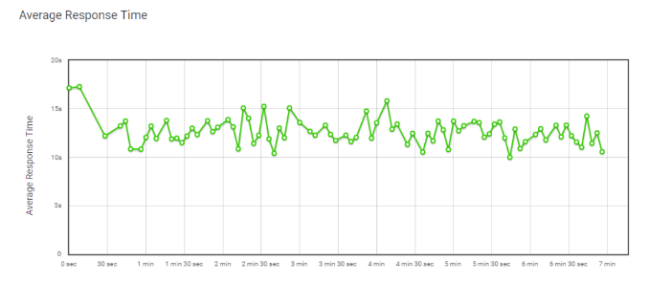
DOTCOM-MONITOR

Slide 26
PERFORMANCE TESTING
Determine how a system performs in terms of responsiveness and stability under a particular workload.
Involves response time, throughput etc. and load, stress and speed testing.
TOOLS USED
Pingdom
Keycdn
GTMetrix
Page Insight

Slide 27
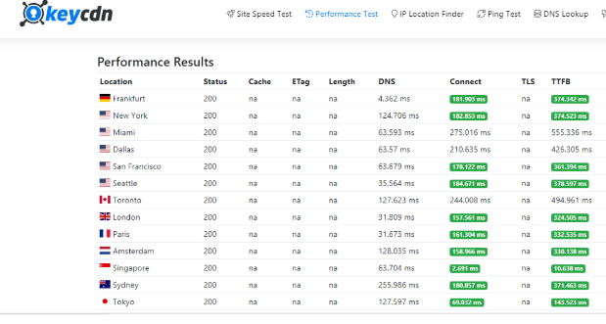
KEYCDN

Slide 28
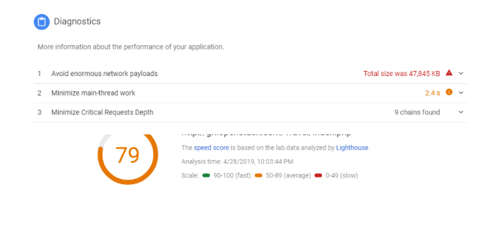
PAGE INSIGHT

Slide 29
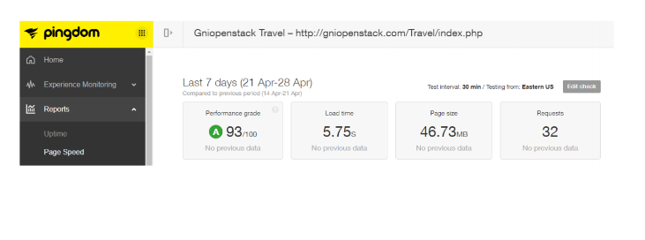
PINGDOM

Slide 30
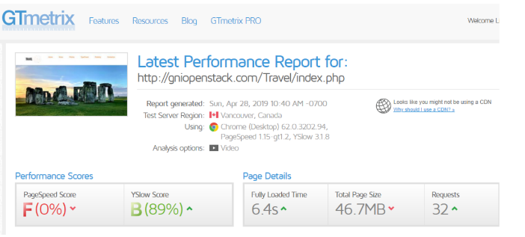
GTMETRIX

Slide 31
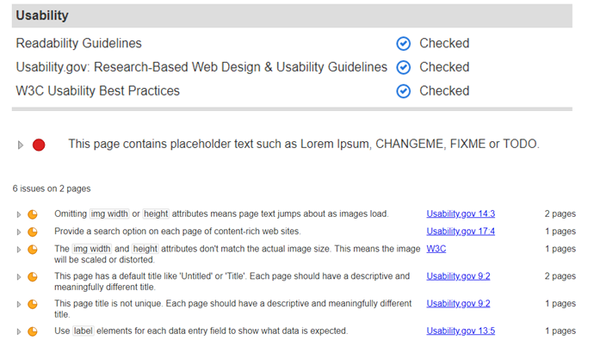
USABILITY TESTING

Slide 32
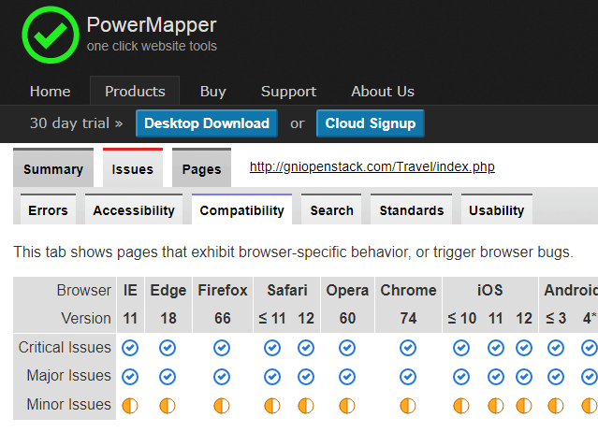
CROSS-BROWSER COMPATABILITY

Slide 33

SELENIUM TESTS
Locate an HTML element on the Web page
Perform an action on an HTML element.
AUTOMATE WEB BROWSER INTERACTION
Anticipate the browser response to the action.
Run tests and output test status

Slide 34
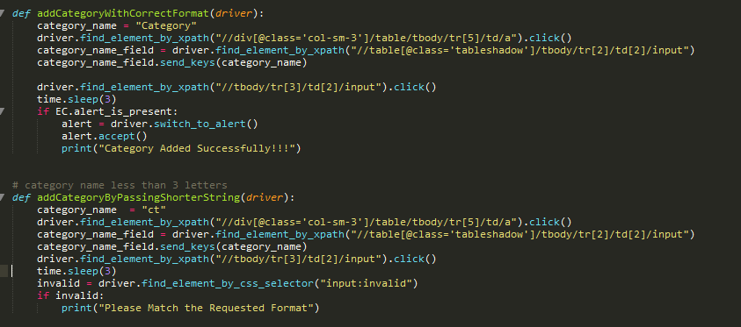
CATEGORY TEST
Testing By
Correct Format
Shorter string
In category name

Slide 35
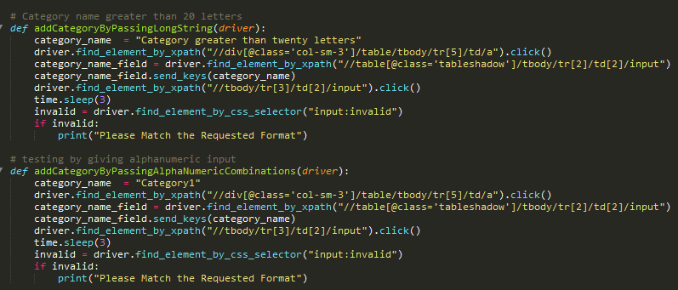
ADDING CATEGORY
Testing By
Long String
Alpha Numeric Combination
In category name

Slide 36
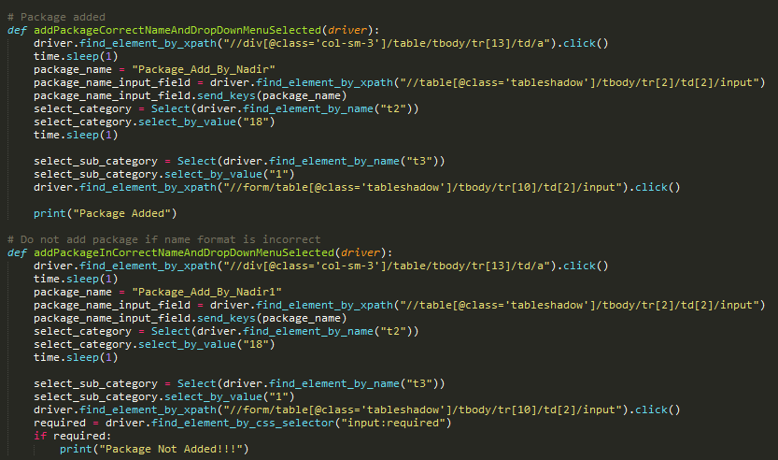
ADDING PACKAGE
Adding Package by
Correct name & drop down menu Selection
Incorrect Name & drop down menu Selection

Slide 37
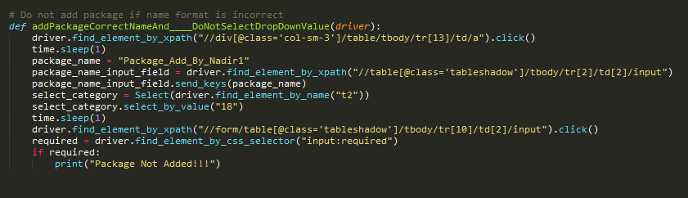
ADDING PACKAGE
Place your screenshot here
Adding Package by
Correct name & don’t select Drop down Menu

Slide 38
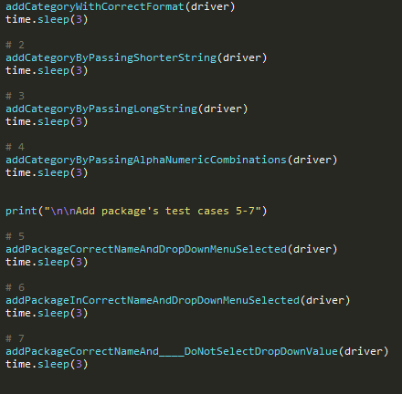
TESTING
Place your screenshot here

Slide 39

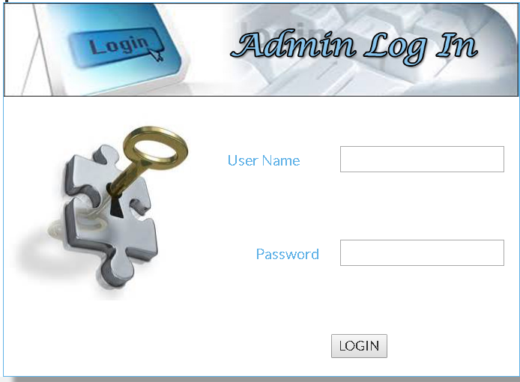
WHITE BOX TESTING:
White Box Testing is defined as the testing of a software solution's internal structure, design, and coding.
Testing:
Testing of each statement, object, and function on an individual basis
The flow of specific inputs through the code
Expected output

Slide 40
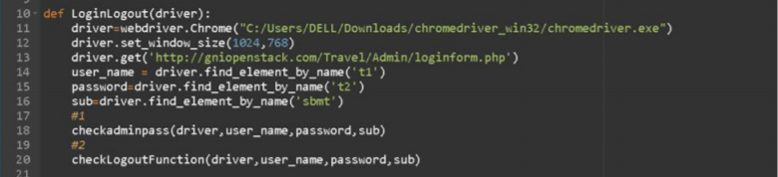
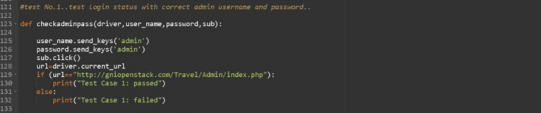
TESTS

Slide 41
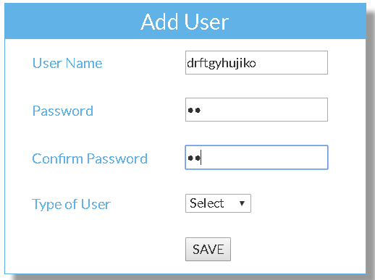
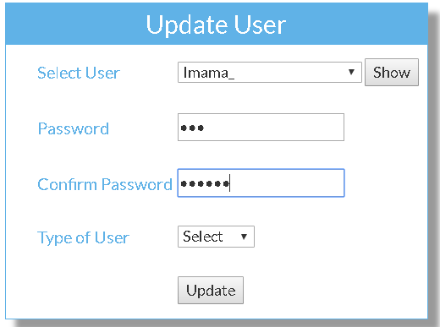

BLACK BOX TESTING:
We tried to cover all the main functions, all the input forms fields, their valid and invalid cases.
Testing:
adding/deleting/updating new users
adding/deleting categories/packages
Navigating through many of the foundational pages and clicking on key areas

Slide 42
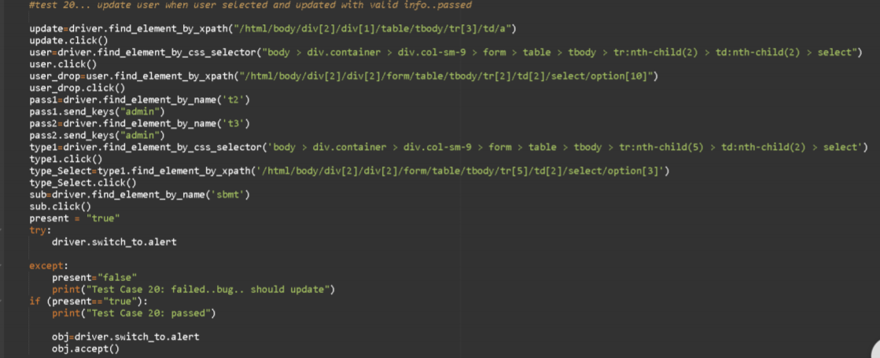
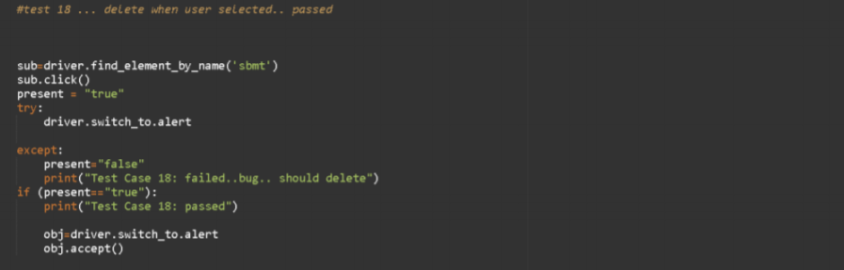
TESTS

Slide 43
CATEGORY TEST
Testing By
Correct Format
Shorter string
In category name

Slide 44
ADDING CATEGORY
Testing By
Long String
Alpha Numeric Combination
In category name

Slide 45
Adding Package
Adding Package by
Correct name & drop down menu Selection
Incorrect Name & drop down menu Selection

Slide 46
ADDING PACKAGE
Place your screenshot here
Adding Package by
Correct name & don’t select Drop down Menu

Slide 47
TESTING
Place your screenshot here

Slide 48

BUGS

Slide 49
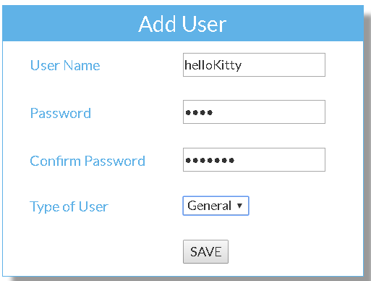
Description: We had to verify that admin is not able to add new user with password and confirm password fields different but the system allows this.
BUG#01
Expected Output: Javascript Error message appears, stays on the same page Actual Output: The user was successfully added
Impact The customer might not be able to login due to multiple passwords

Slide 50
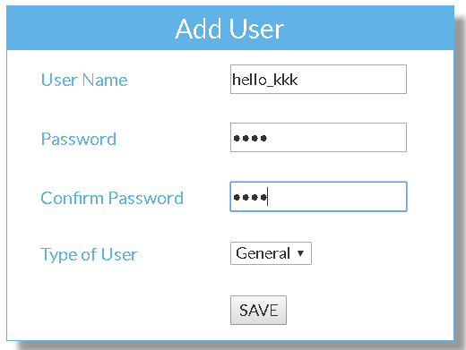
Description: We had to verify that admin is not able to add new user with a username containing underscore
BUG#02
Expected Output: Javascript Error message appears, stays on the same page Actual Output: The user was successfully added
Impact The customer may have a problem remembering his/her username with the special character

Slide 51
Description: We had to verify that admin is not able to add new user with a username containing more than 10 characters
BUG#03
Expected Output: Javascript Error message appears, stays on the same page Actual Output: The user was successfully added
Impact The customer might have a difficulty remembering long usernames

Slide 52
Description: We had to verify that admin is not able to update users when a user is selected but provided with mismatching password and confirm password fields
BUG#04
Expected Output: Javascript Error message appears, stays on the same page Actual Output: The user was successfully added
Impact The customer might not be able to login due to multiple passwords

Slide 53
Description: The Admin login page is not accessible through any hyperlink on the main page: it is only accessible through writing a direct URL: http://gniopenstack.com/Travel/Admin/loginform.php
BUG#05
Expected Output: A hyperlink or admin tab be present in the home page Actual Output: No such hyperlink or admin tab is available through which admin can login or perform administrative tasks
Impact The admin will have difficulty logging in and performing all the important administrative tasks, adding categories and packages to the website, etc.

Slide 54
Description: The Home page tab on the home page does not redirect to itself
BUG#06
Expected Output: The hyperlink is not working. Actual Output: The home page hyperlink would be working
Impact Harder to navigate to home tab after going to another tab

Slide 55
Description: The About tab does not redirect website to About page
BUG#07
Expected Output: The hyperlink is not working. Actual Output: The About Tab hyperlink would be working
Impact Customer will have to scroll down page manually to find About page details instead of being redirected automatically by clicking a hyperlink

Slide 56
Description: The Contact page tab on the home page does not redirect to contact Page
BUG#08
Expected Output: The hyperlink is not working. Actual Output: The Contact Us hyperlink would be working and would redirect the user to a new page or to a place within the home page displaying the contact details.
Impact The customer will have to manually scroll down the Home page to find contact details instead of automatic redirection through hyperlink.

Slide 57
CONCLUSION
It is safe to conclude that the system has been thoroughly tested.

Slide 58
CHALLENGES FACED
Finding the appropriate Online Tools for all the possible testing
Finding all the possible test cases for the website
Making the website Live
Figuring out all possible testing strategies

Slide 59
FUTURE IMPROVEMENTS
Admin Login Page
Adding hyperlink or tab on home page to access Admin login page
Home page
Hyperlink of Home page should Redirect to itself
About Page
Hyperlink of about page should redirect
to about page
Contact Us Page
Hyperlink of Contact us page should redirect to contact us place

Slide 60
Adding User Check for adding user with underscore in name
Adding User
Check for adding user with more than 10 characters
Adding User
Check for Adding user with password and confirm password fields mismatched
Updating User
Check for Updating User with password and confirm password fields mismatched

Slide 61
Admin Login Page
Adding hyperlink or tab on home page to access Admin login page
Home page
Hyperlink of Home page should Redirect to itself
About Page
Hyperlink of about page should redirect
to about page
Contact Us Page
Hyperlink of Contact us page should redirect to contact us place

Slide 62
Adding User Check for adding user with underscore in name
Adding User
Check for adding user with more than 10 characters
Adding User
Check for Adding user with password and confirm password fields mismatched
Updating User
Check for Updating User with password and confirm password fields mismatched

Slide 63
Thankyou!

